Slide 1
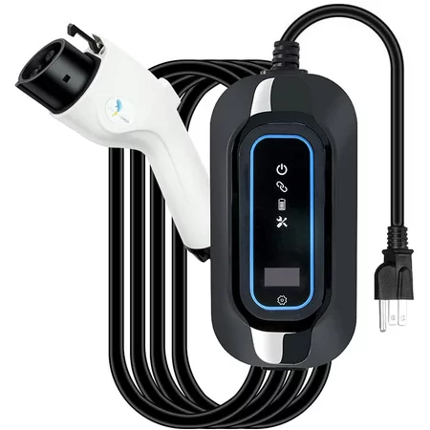
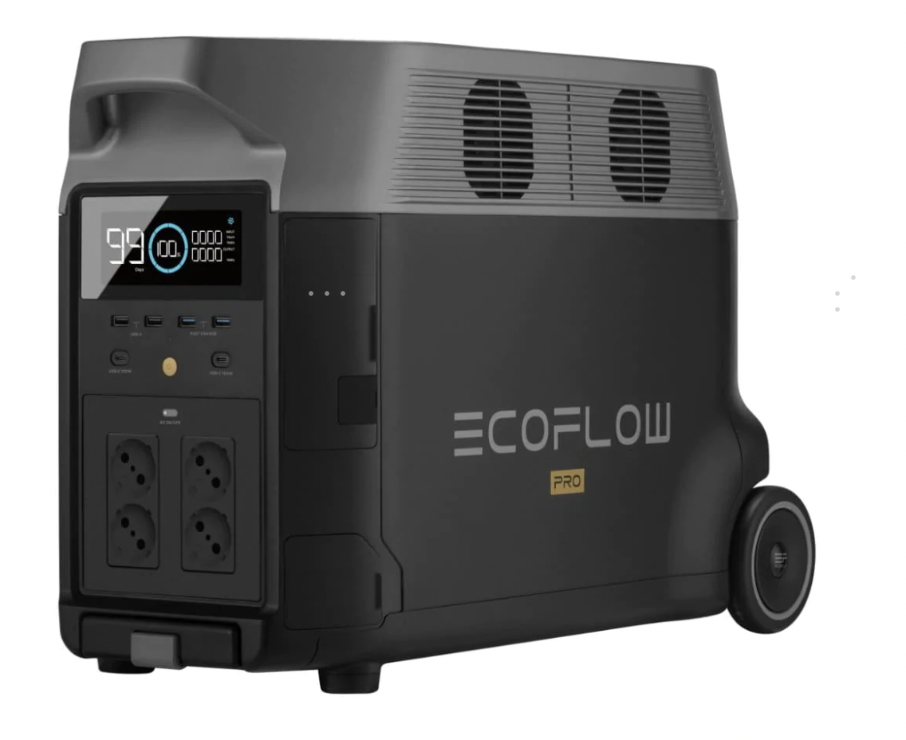
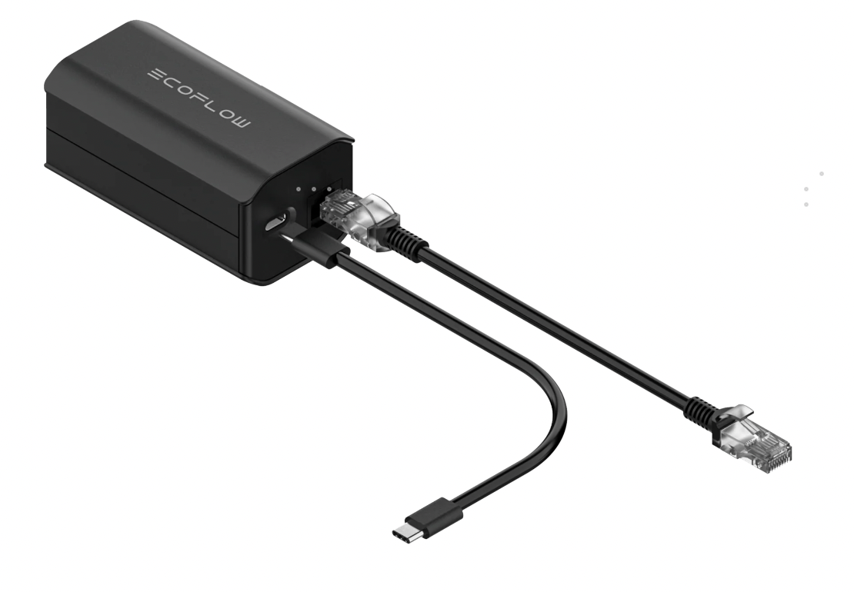
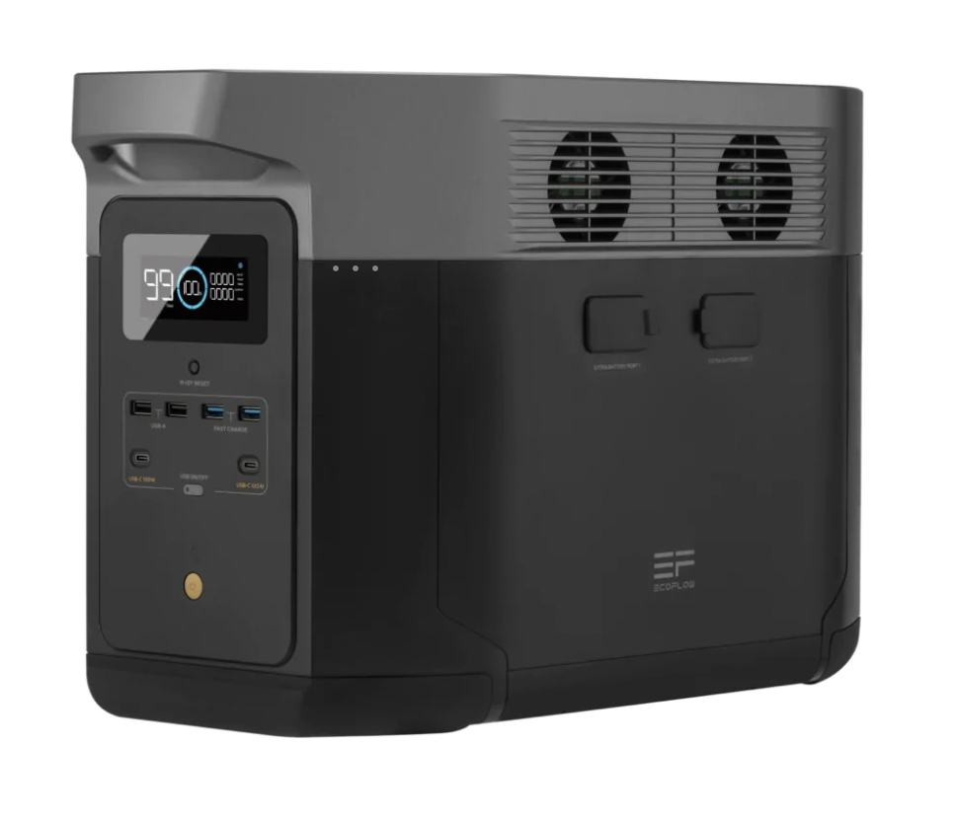
Charging EV
Delta Pro
Or
Delta Max
Grounding Adaptor
EV Charging Cable
(User need to get this)
1）Connect grounding adaptor with Delta Pro/Max(connect the communication port and AC port according to the instruction manual)
https://app.box.com/s/q3gi5izcnfa5p994asexhoosv9bsv3g9
2) Connect the EV Charging Cable to Delta Pro/Max, then connect to EV to begin charging.
Note: We’ve tested on a Tesla Model 3, and ever 1kWh is capable of providing and extra 6 – 7km

